Slide 1

WELCOME TO

Slide 2
INTRODUCTION
Innovative Academy was set up by tech enthusiasts in 2015 to share their knowledge of technology with the world. The objective was to redefine the future by providing the best IT certification training in Bengaluru. The career-oriented training incorporates an upgraded curriculum taught by experts in the tech industry. Our academy believes in providing quality education that helps our candidates secure positions in top MNCs.

Slide 3
IT COURSES WE OFFERED

Slide 4
Hardware & Networking
A+
N+
Basic Computer
CCNP
CCNP

Slide 5
Cloud Computing
Linux
(RHSCA)
AWS
AWS DevOps
AZURE - 900
AZURE - 104
AZURE DevOps

Slide 6
Software Training
C, C++
Core Java
Advance Java
Python
Java Full Stack

Slide 7
HARDWARE ESSENTIALS(A+)
Duration : 30 Hours Potential Career Path : IT Support Specialist , Help Desk… For Whom : Anyone and Everyone Next Pursued Certification : N+
Key Sills : Basic Electronics, Troubleshooting and Repair, Microcontroller…

Slide 8
NETWORKING ESSENTIALS(N+)
Duration : 30 Hours Potential Career Path : Network Engineer, Network Administrator… For Whom : Anyone and Everyone Next Pursued Certification : CCNA
Key Sills : Networking Protocols, Router and Switch Configuration, Network Security…

Slide 9
CCNA
Duration : 40 Hours Potential Career Path : Technical Support Engineer, Systems Administrator, VoIP Engineer… For Whom : Who has Completed N+ Next Pursued Certification : CCNP
Key Sills : IP Addressing and Subnetting, Wireless Networking, Basic Automation and Programmability ….

Slide 10
CCNP
Duration : 120 Hours Potential Career Path : Network Architect, Senior Network Engineer, Cloud Network Engineer… For Whom : Who has Completed N+, CCNA
Key Sills : Layer 2 Technologies, Quality of Service (QoS), Advanced Routing Protocols…

Slide 11
Linux – RHCSA
Duration : 40 Hours Potential Career Path : Linux System Administrator, Linux Support Engineer, Linux Engineer…
For Whom : Who has Completed N+, CCNA
Key Sills : Linux Fundamentals, System Monitoring and Performance Tuning, Security Practices…

Slide 12
AWS - SAA
Duration : 40 Hours Potential Career Path : Cloud Solutions Architect, AWS SysOps Administrator, AWS Solutions Developer…
For Whom : Who has Completed N+, CCNA, Linux
Key Sills : Cloud Computing Fundamentals, AWS Services, Networking on AWS, Security Best Practices including Projects…

Slide 13
DevOps
Duration : 40 Hours Potential Career Path : Cloud Engineer, DevOps Engineer, Cloud Security Engineer …
For Whom : Who has Completed N+, Linux, AWS
Key Sills : Continuous Integration and Continuous Deployment (CI/CD), Version Control Systems including Projects…

Slide 14
Azure – 900 & 104
Duration : 40 Hours Potential Career Path : Azure Governance, Security, Privacy, Compliance, Identity and Access Management…
For Whom : Who has Completed N+, AWS
Key Sills : Managing Azure Subscriptions and Resources, Backup and Recovery…

Slide 15
C & C++
Duration : 50 Hours Potential Career Path : Backend Developer, Gaming Developer…
For Whom : Anyone or Everyone.
Key Sills : Programming Fundamentals, Object Oriented Programming(OOP), Exception Handling, File Handling incuding Projects…

Slide 16
Python
Duration : 35 Hours Potential Career Path : Python Developer, Backend Developer…
For Whom : Anyone and EveryOne
Key Sills : Fundamentals of Python, Modules and Packages, Functions…

Slide 17
Java – Core & Advance
Duration : 50 Hours Potential Career Path : Backend Developer, Gaming Developer…
For Whom : Anyone or Everyone.
Key Sills : Java Fundamentals, Object Oriented Programming(OOP), Collections, Multithreading, GUI Applications…

Slide 18
Java Full Stack
Duration : 120 Hours Potential Career Path : Java Full Stack Developer, Java Developer, Backend Developer…
For Whom : Anyone and Everyone
Key Sills : Web Designing, Core Java, Advance Java, Spring Boot, SQL, RestAPI including Projects…

Slide 19
OUR FACULTY

Slide 20
Cloud Trainer
Name : Yagnesh SH Designation : Technical Manager
Qualification : BCA
Course : Linux, AWS, DevOps
Experience : 13+ Years

Slide 21
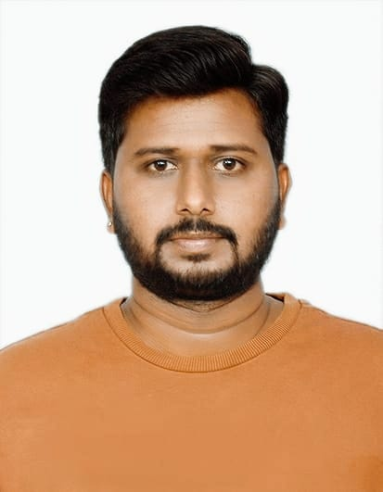
Hardare & Networking Trainer
Name : Naveen S Designation : Senior Technical Trainer
Qualification : BCA
Course : Computer Essentials, A+, N+, CCNA
Experience : 8+ Years

Slide 22
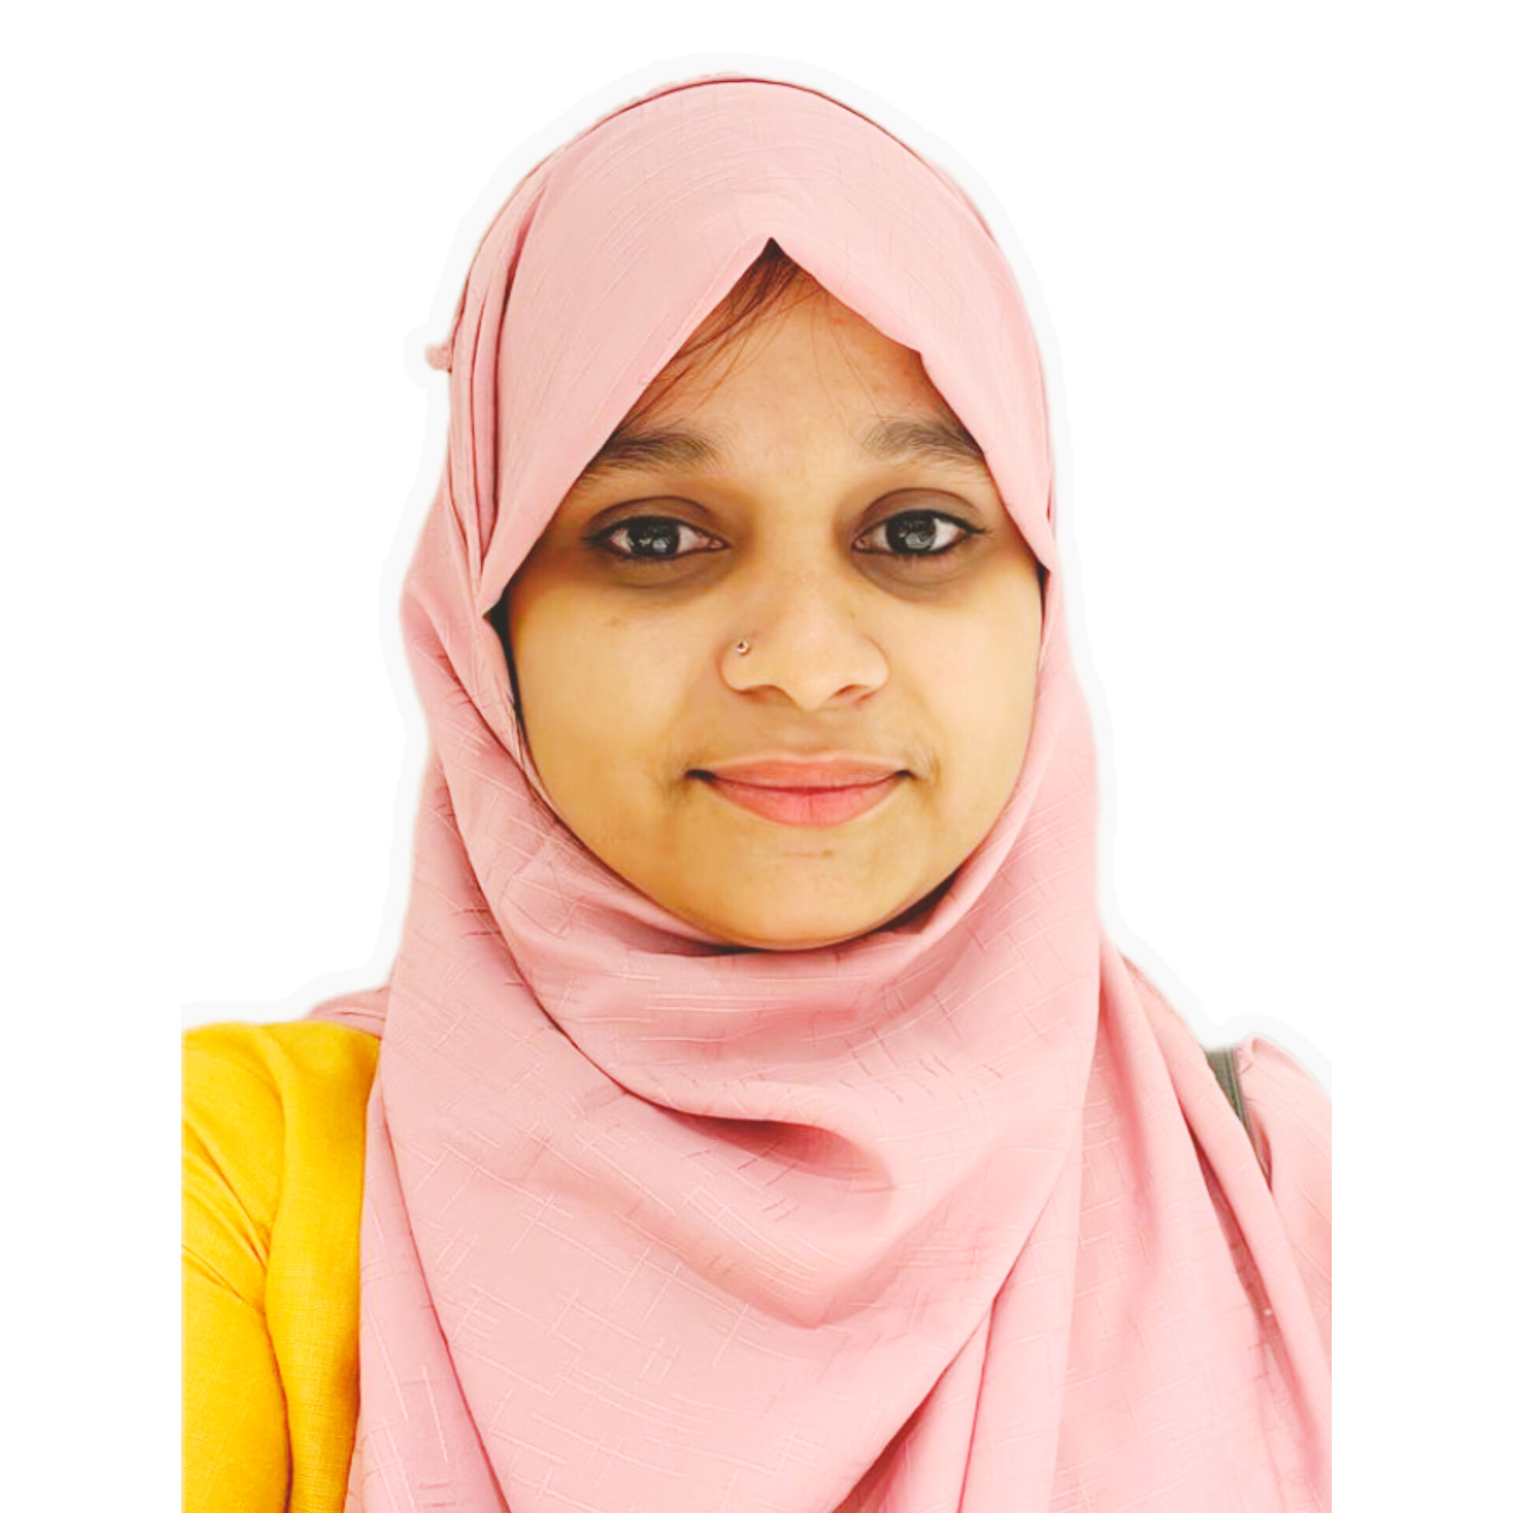
Software Trainer
Name : Roshni S Designation : Technical Trainer
Qualification : BE - CSE
Course : C, C++, Java Full Stack
Experience : 3+ Years

Slide 23
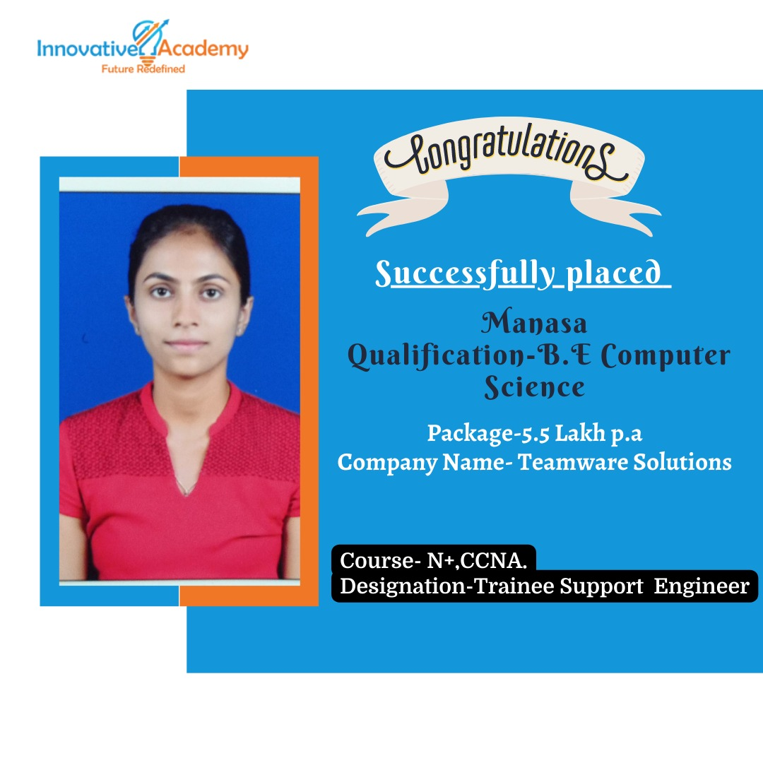
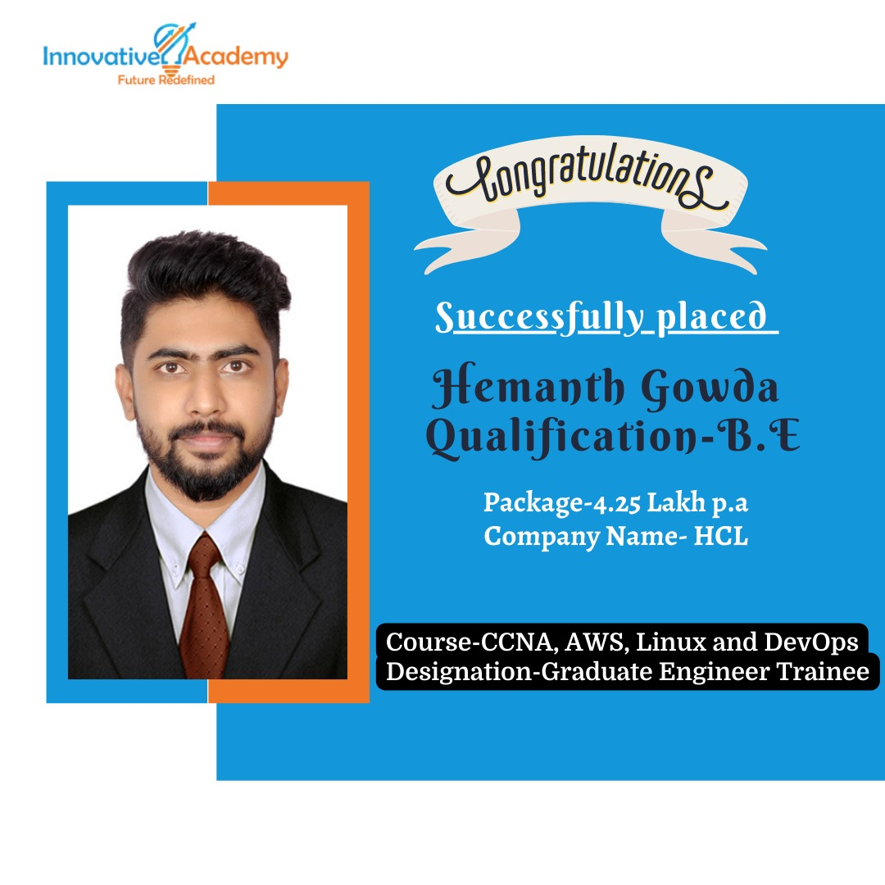
Student Placed

Slide 24
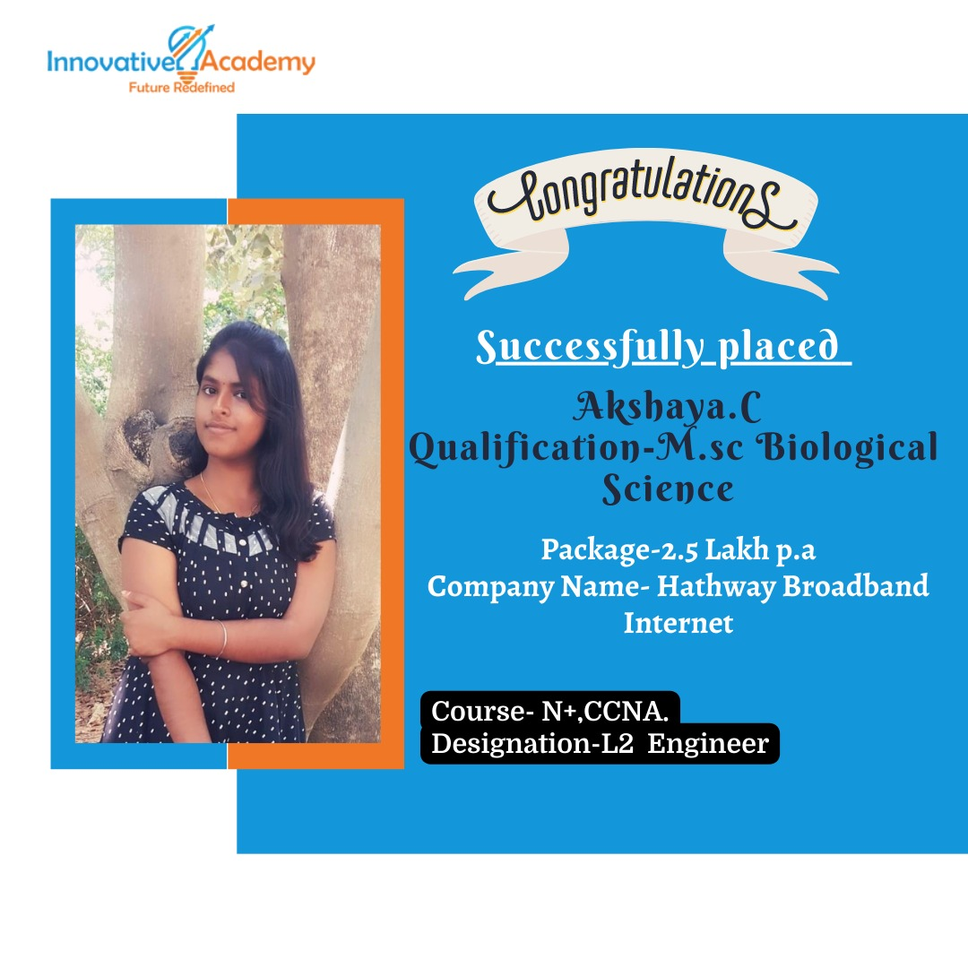
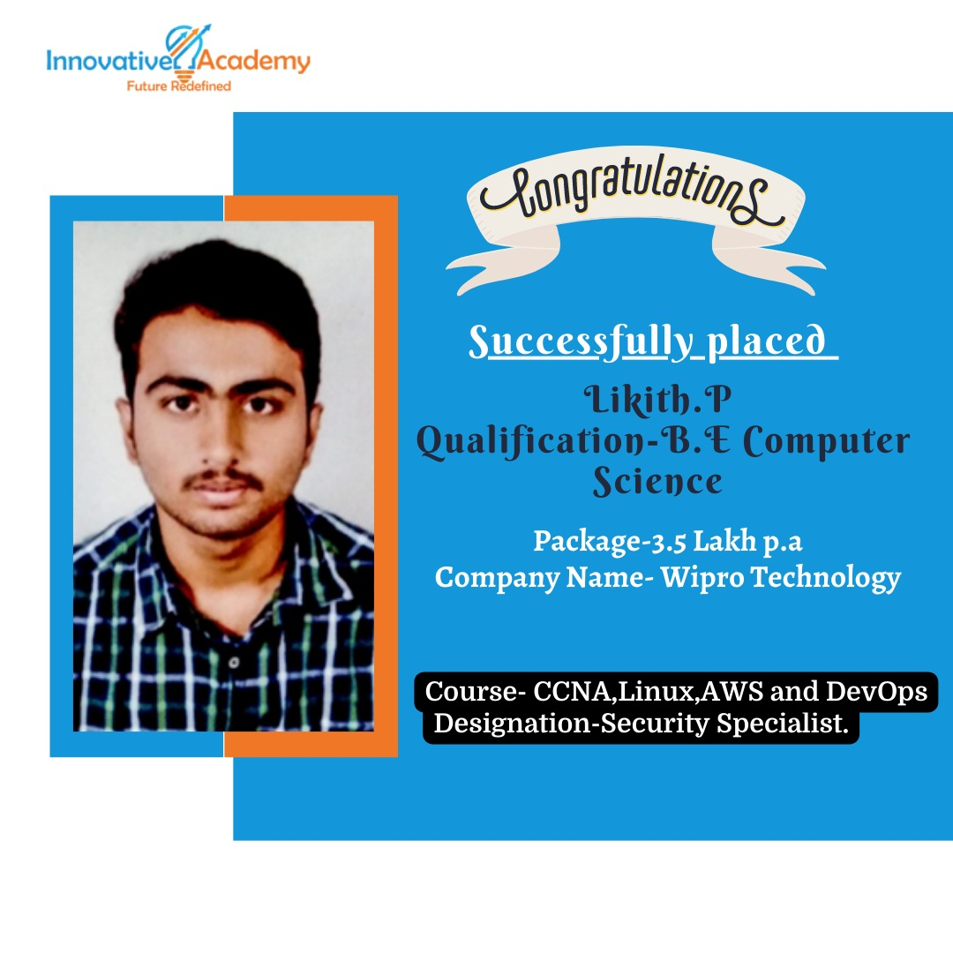
Student Placed

Slide 25


Student Placed

Slide 26
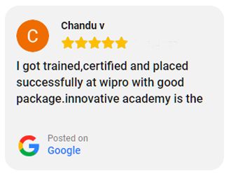
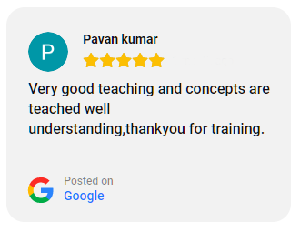
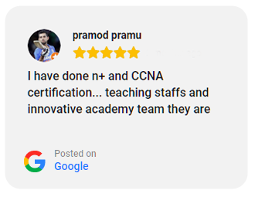
Students Feedback

Slide 27
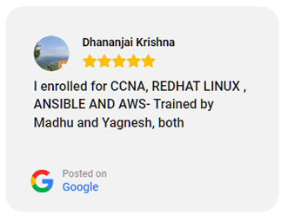
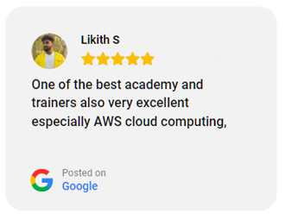
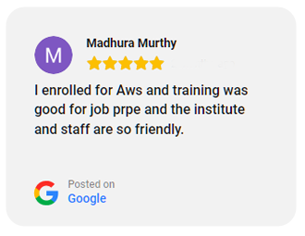
Students Feedback

Slide 28
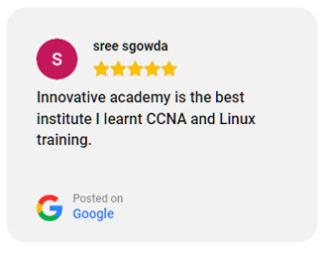
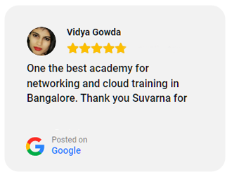
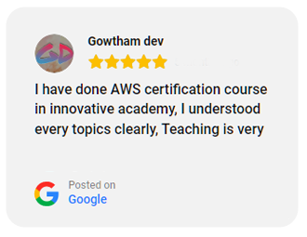
Students Feedback

Slide 29
Current Openings
IT Support System Admin
Company : ZeOmega
Experience : 0-2 years
Salary : 1.8 LPA – 3 LPA
Location : Basvangudi, Bangalore.
DevOps Engineer
Company : Infineon Tech.
Experience : 3 years
Salary : 8 LPA
Location : Bangalore.

Slide 30
Current Openings
Network Engineer
Company : Harman India
Experience : 3 YEARS
Salary : 3 LPA – 6 LPA
Location : Bangalore
AWS Network & Server Engineer
Company : Infiniti Research Ltd.
Experience : 2 years
Salary : 3 LPA – 5 LPA
Location : Bangalore.

Slide 31
Current Openings
Software Developer
Company : NTT DATA
Experience : 0-2 YEARS
Salary : 3 LPA – 6 LPA
Location : Bangalore
Java Developer
Company : Xformics Inc.
Experience : 3-5 YEARS
Salary : 6 LPA – 9 LPA
Location : Bangalore

Slide 32
Thank You

